Slide 1
Grade Inflation and Deflation
Chyanne Gouveia
Logan Uyetake
Kauila WongYuen

Slide 2
What should a grade represent?
A Student’s understanding of different concepts they have learned.
Teacher’s should also take into consideration non-academic behavior such as how well a student performs in class, homework, and participation.
Notes:
You need an introduction to the problem-this should address what you feel a grade should represent.

Slide 3
The Problem
Inaccurate reporting methods related to academic performance has a negative impact on college and high school students. Grade inflation practices are being used in higher education institutions including UH-Hilo and UH-Manoa and less in community colleges and trade schools. Grade deflation can reslut in students being denied post-secondary learning opportunities.

Slide 4
The Problem (Cont.)
In other words, colleges and universities are inflating or deflating grades which made students believe they were better or worse at some things because their grades didn’t accurately reflect on what they really understood and comprehended.
Notes:
You present the problem yet limited description to reporting practices in general-are you addressing college/university?
You do not provide examples to support why its a problem-why should the viewer be concerned?

Slide 5
Background Knowledge
Grade Inflation – Increasing someone’s grade when it might not be deserved. The professor might be grading too easily.
Grade Deflation – Lowering someone’s grade and teacher’s grading too harshly.

Slide 6
Factors
A teacher’s relationship with the student.
Sometimes they pity students or don’t want to demotivate them by giving lower grades. They want to be liked.
Tradition/Belief
Some teachers inflate/deflate grades because other teachers are doing it and they feel it is okay to do it.
It’s the nature of the school, so why fight the system?
Teacher’s lie to themselves and others.
Teacher’s inflate grades, to make students happy but they claim they do not.
Other times, they believe that because other teacher’s don’t inflate grades they feel they couldn’t be guilty of it either because they are the same.

Slide 7
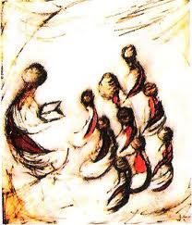
Factors (Cont.)
Money
Generous grading gives better teacher reviews, thus, more students will be trying to get into that school and the school will earn more money for the books and classes that students will be paying for.
Students
Some don’t try to do the work resulting in bad grades while some feel no need to do the work because they feel they’ll be getting a high grade no matter what due to grade inflation.
The amount of stress put on a student because of how hard they have to work without getting a higher grade in the end makes them feel less of themselves and less willing to do the work. This is caused by grade deflation.
Notes:
Cause/effect should address how inaccurate reporting practices can result in negative effects to student or others that need the grades.

Slide 8
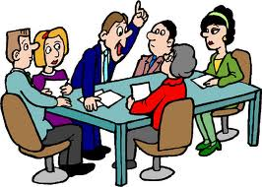
Where did this all come from?
Our group had found the factors to this problem as well as a few other things by applying our background knowledge to what we learned from articles that we have read along with discussing things with each other to come up with different outcomes.
Notes:
What are your sources? Reading assignment? Experiences?

Slide 9
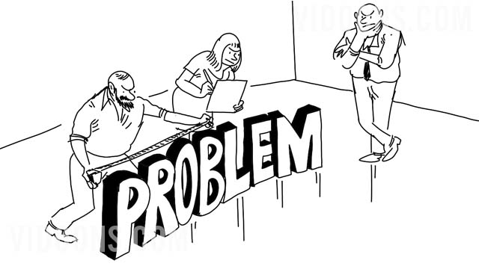
Solutions
Teachers:
If teachers accept the personal responsibility to refuse to inflate grades, then the grade-inflation problem would ultimately solve itself.
Talking with the student about how a teacher will grade (“I may be grading you a little stricter but it doesn’t mean I don’t care for you.” )
Being honest with their students instead of giving them false hope.
Learning new ways of teaching that could benefit both teacher and student.

Slide 10
Solutions (Cont.)
Students
Don’t give up or try to take the easy way out because it won’t get you anywhere in life.
Both Teachers and Students
Learn about the different grading scales: find which scale is more effective and would benefit both teacher and student, what should a teacher be grading and how, etc.
Notes:
Your solutions are not really solutions in their current state. For instance, how are you going to get teachers to take personal responsibility? Are teacher really the problem? What if I tell you that there are policies that allow such practices to be in place. Can you fault teachers for executing policies?
Is changing to the 4 scale a solution when there is not training to understand why the current scale is inaccurate? You haven't provided evidence on why this scale is more appropriate to use to reporting grades. Nor explained its importance or value.

Slide 11
Some Helpful Information
http://www.youtube.com/watch?v=Sga8n0y6nIk
This video touches up on grade inflation at BYU – Idaho.
http://www.youtube.com/watch?v=dRcjOHhxiuM
This video talks about grade deflation and competition between students in Princeton.
Notes:
How could images, audio, video, url links, references help improve the quality of your presentation?

Slide 12
Some Helpful Information (Cont.)
http://www.youtube.com/watch?v=fQa-gJ0bEdI
Stanford's Hoover Institute interviews Harvard Professor of Government Harvey Mansfield on grade inflation in Harvard.

Slide 13
This Concludes PBL # 1

